Slide 1



Projects:
Variations in genomic methylation profile related to meat tenderness and feed efficiency in beef cattle Nellore
Methylome and allele specific expression in Nellore with extreme fenotype for feed efficiency
Marina Ibelli Pereira Rocha
Marcela Maria de Souza
supervisor: Dr. Simone Cristina Méo Niciura

Slide 2
Goals
Analyze the ASE profile in the transcriptome and compare the profile among animals with extreme phenotype for Residual Feed Intake (RFI);
Characterize the methylation profile of the genome and identify differentially methylated regions (DMR) between the extreme phenotype animals; → RFI
→ meat tenderness
Integrate the results to previous results of GWAS and differentially expressed genes.

Slide 3
Animals
Samples of liver and muscle
RNA extraction
DNA extraction
Diferentially expressed genes
Meat tenderness/RFI
Genotyping
RNA-seq
GWAS
Methylome Analysis
Allele-specific expression (ASE)
Integration of the results
Allele-specific methylation Analysis

Slide 4
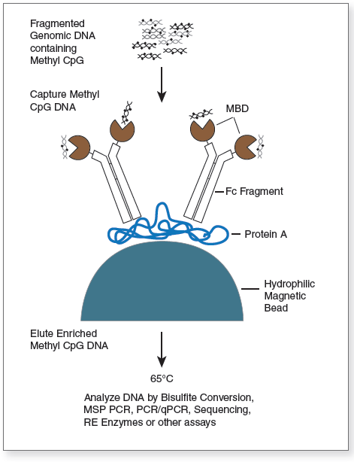
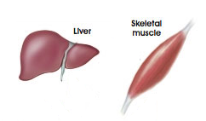
Material and Methods
Analysis of Methylation Profile
Liver and muscle tissue
12 samples, 6 of each extreme fenotype
DNA extraction from frozen tissue
kit DNeasy Blood & Tissue (Qiagen)
Methylated DNA enrichment → MBD-seq
(methyl-CpG binding domain proteins)
kit EpiMark® Methylated DNA Enrichment (NEB)
Treatment of DNA enriched with bisulfito
Kit EZ DNA Methylation-Lightning (Zymo)

Slide 5
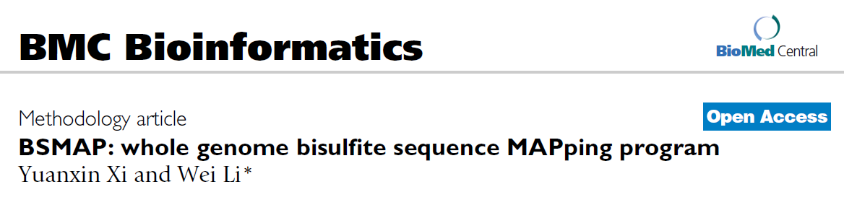
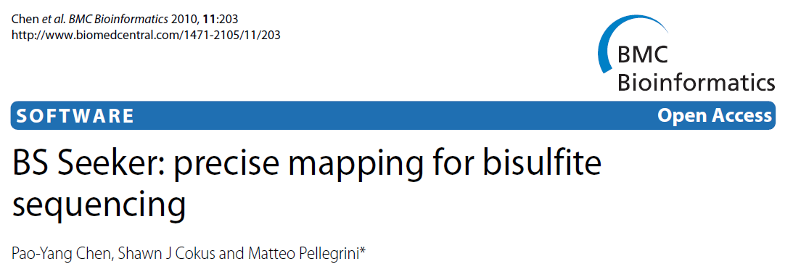
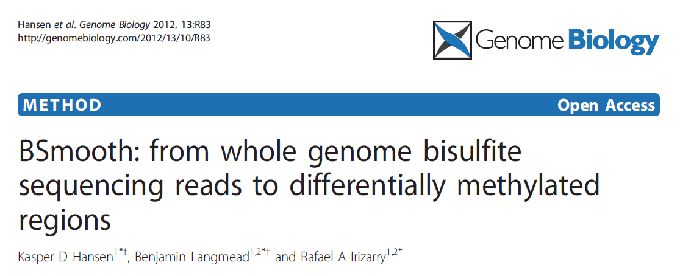
Material e Métodos
Sequencing
HiSeq2500 (Illumina)
Analysis of the results
?????????
Identification of defferentially methylated regions (DMR)

Slide 6
Therefore, the development of this project will add new layers of information to the results of the other projects allowing the enrichment of the information to be used in breeding and animal selection.

Slide 7

Obrigada!!!

